Slide 1
Implementation and software
Project#1 (5 points)

Slide 2
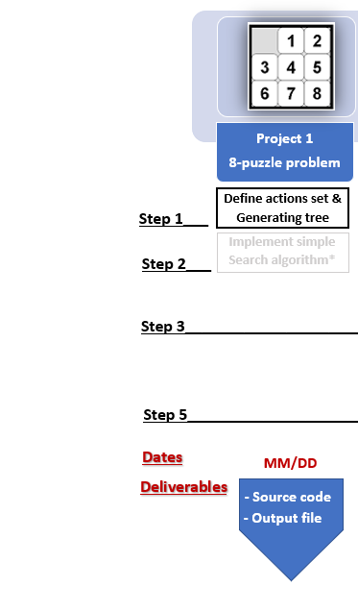
Project 1
Implement simple search algorithm

Slide 3
Project -1 Description
Find all the possible states of the 8-Puzzle starting from the given initial state until the goal node is reached. Note that, the states should be unique (no repetitions).
From the initial state of the puzzle, use different moves in all the directions to generate new states, check the validity of the newly generated node.
You should use Python for programing
Use the Breath First Search(BFS) to find the path to reach the goal.
Implement back tracking to find the plan to solve the problem

Slide 4
Example

Slide 5
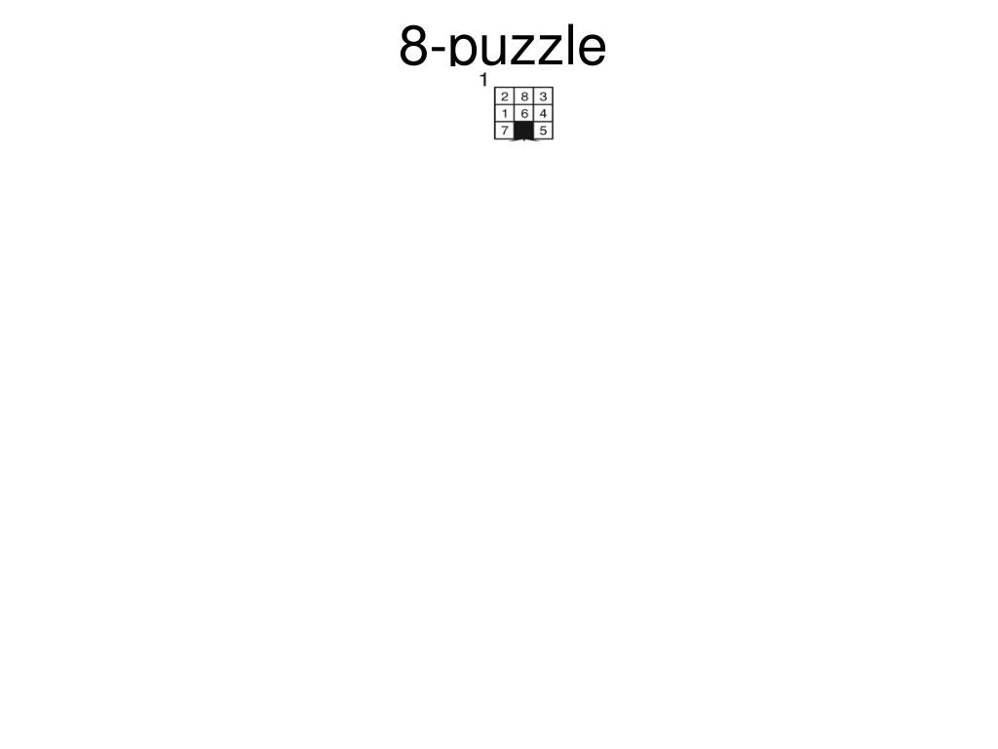

Slide 6
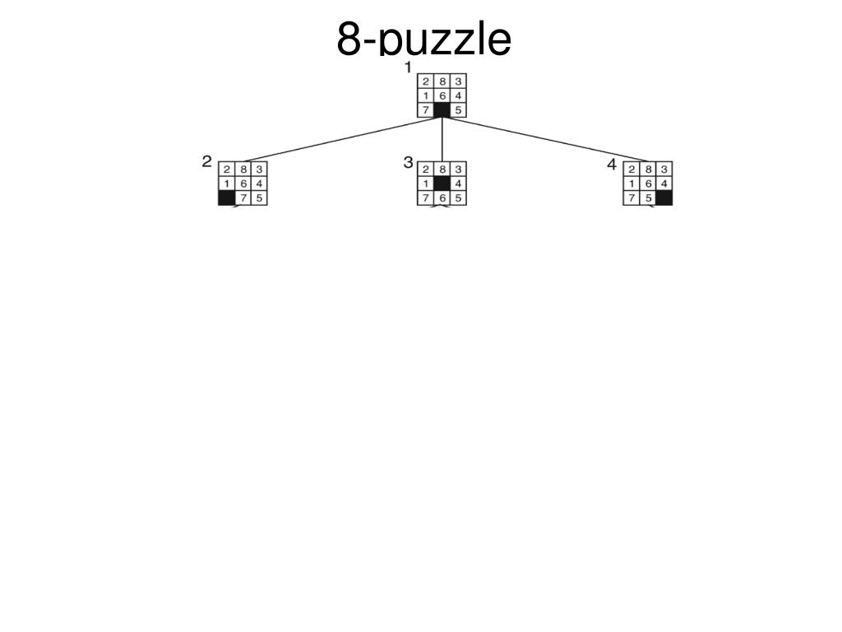

Slide 7
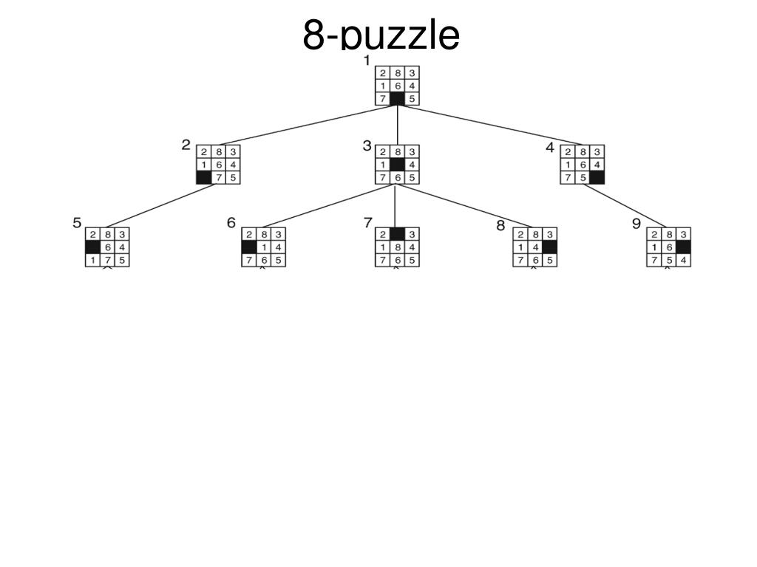

Slide 8
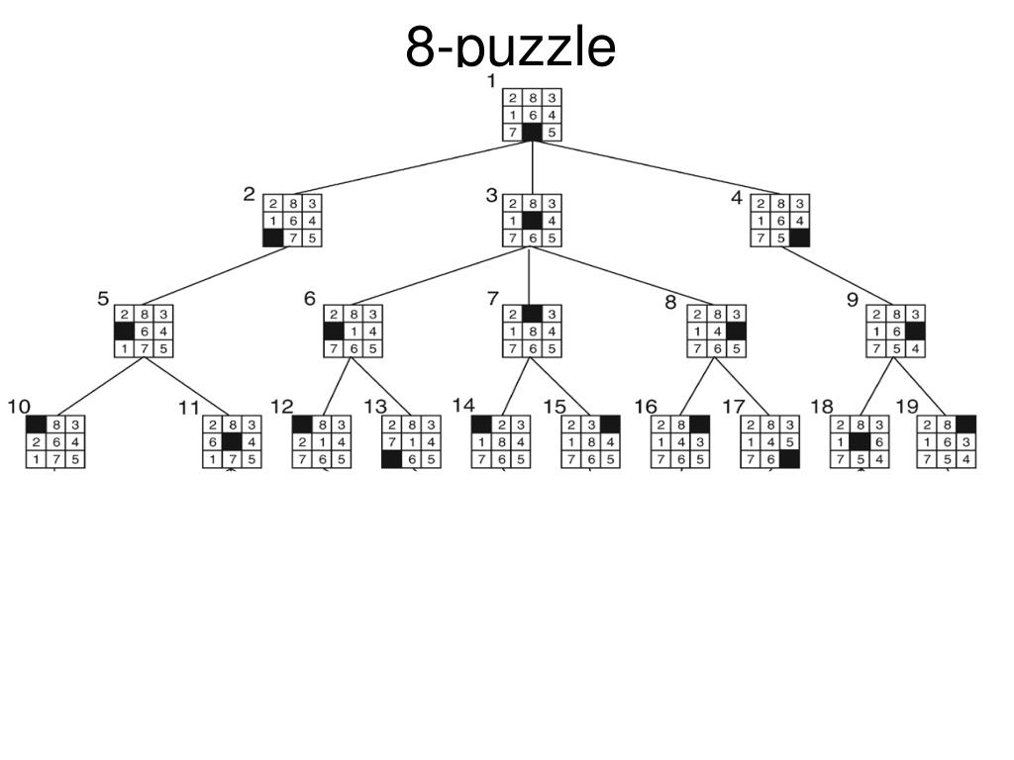

Slide 9
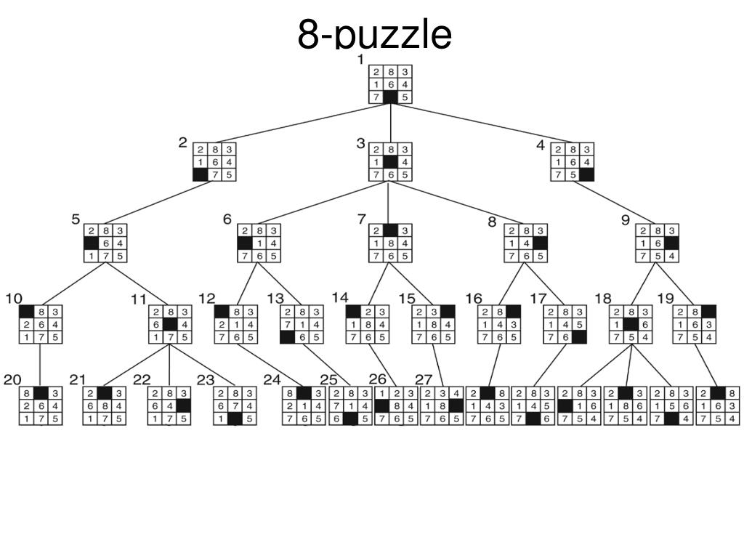

Slide 10
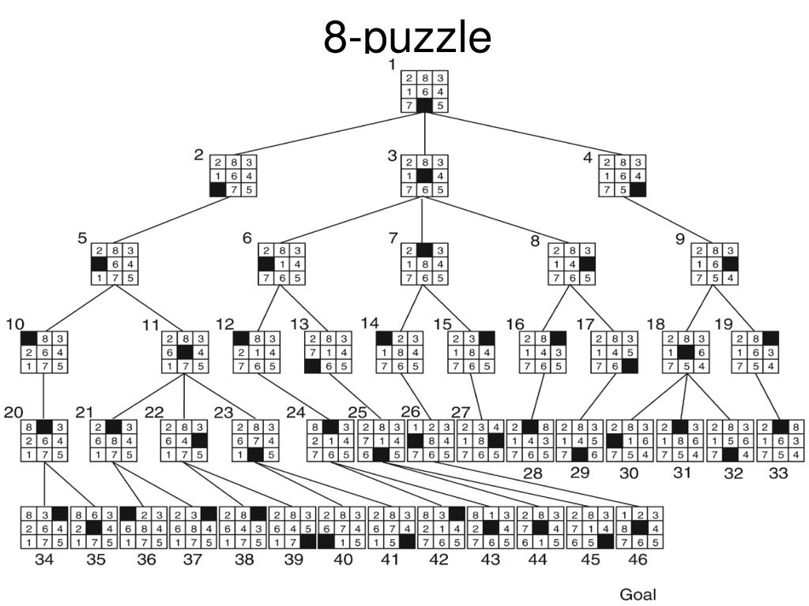

Slide 11
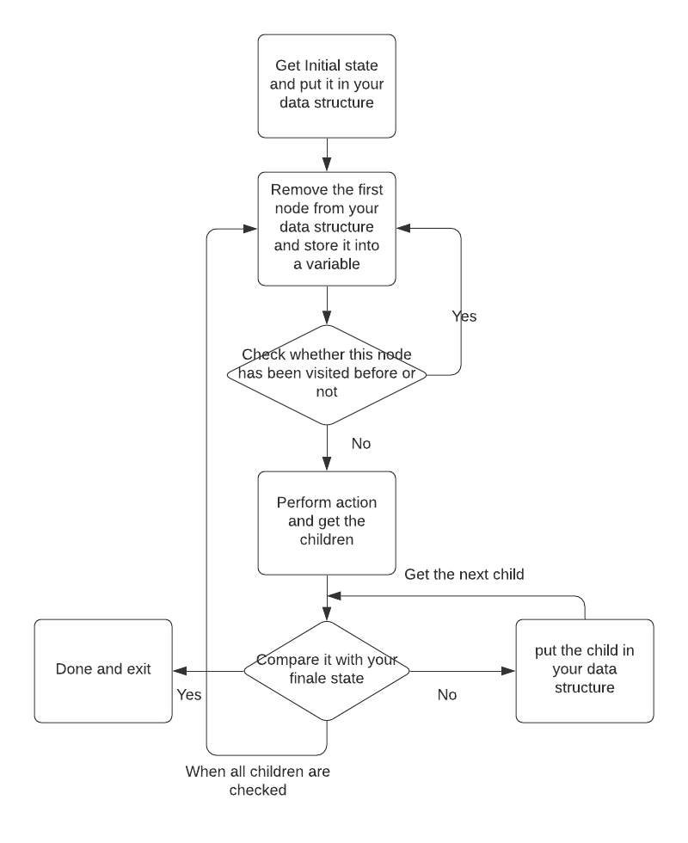
Flow chart
Start
Locate blank tile and

Slide 12
Suggested Parameter Names
Information to be stored in the data structure for each node:
Node_State_i: The state of node i is represented by a 3 by 3 matrix, for example [ 1 2 3; 4 5 6; 7 8 0].
Node_Index_i : The index of node i
Parent_Node_Index_i: The index of parent for node i.

Slide 13
1-First Step
You should first select a data structure type to save your generated nodes.
There are different types of data structure that could be used. The type of data structure is optional.
Hint: Read about stacks and queues

Slide 14

Data structure in PYTHON
Review the “list” and “dictionary” data structures for python in the following link
1) Learn Python - Full Course for Beginners [Tutorial] (Links to an external site.)
2) https://www.youtube.com/watch?v=tw7ror9x32s
3) https://www.linkedin.com/learning/learning-python-2/welcome (Links to an external site.)
4) https://www.linkedin.com/learning/programming-foundations-data-structures-2/understand-data-structures (Links to an external site.)
5) https://www.linkedin.com/learning/python-data-structures-stacks-queues-and-deques/python-data-structures-primer (Links to an external site.)
6) Textbook: http://do1.dr-chuck.com/pythonlearn/EN_us/pythonlearn.pdf (Links to an external site.)

Slide 15
2. Step two
Write a function that given the state of the current node in the 8puzzle problem, calculates the location of the blank tile in the 3 by 3 matrix and returns the output as a pair, (i,j). Where 0<i<4 and 0<j<4.
Blanktile can be located using either two for loops or by using inbuilt functions of numpy.
% Find the location of the blank tile

Slide 16
3. Step three
Write 4 subfunctions to move the blank tile in 4 different directions
[Status, NewNode] = ActionMoveLeft(CurrentNode);
% Moves blank tile left, if possible
[Status, NewNode] = ActionMoveRight(CurrentNode);
% Moves blank tile right, if possible
[Status, NewNode] = ActionMoveUp(CurrentNode);
% Moves blank tile up, if possible
[Status, NewNode] = ActionMoveDown(CurrentNode);
% Moves blank tile down, if possible

Slide 17
4. Step four
Append All the possible new nodes in a list
Follow the flowchart (optional) once done
Additional: Focus on checking the node to be explored with the visited list you maintain and if it is present do not repeat the actionset for that node.

Slide 18
5. Step five
Write a subfunctions (generate_path) that uses back tracking to find the path between the initial node and final node.

Slide 19
Additional Notes
Each test case will be allowed to run for a maximum of 10 minutes to be considered for evaluation, i.e. given an initial node, the eight puzzle should be solved within this time.
Randomly 20-25 students will be selected who need to explain their code during TA office hours.

Slide 20
Due Date and Deliverables
Due date: February 19 , 11:59 p.m.
Submit deliverables on Canvas.
Deliverables:
Source code (Should be a python file)
Output textfile to be generated from the code: Nodes, NodesInfo and nodePath.
A text file that explains how to run the program (Readme).
Folder Name (zip) : proj1_firstname_lastname

Slide 21
README
ReadMe
Instructions to run the code, step by step.
Explicitly mention the libraries used in your code

Slide 22
Output textfile to be generated from the code
Textfile 1:
Name: nodePath.txt
The elements are being stored column-wise, i.e. for this state 1 4 7 2 5 8 3 6 0, the eight puzzle state is
1 2 3
4 5 6
7 8 0
The order of the states should be from start node to the goal node.
Textfile 2:
Name: NodesInfo.txt
First column: Node Index
Second Column: Parent Node Index
Textfile 3:
Name: Nodes.txt
All the explored states should be present in the format of nodePath.txt
Look at the sample text files uploaded for more clarity.

Slide 23
Code Visualization
A python file has been provided (plot_path.py) which will help with the visualization of the output text file.
The python file reads the text file (nodePath.txt) generated by your code.

